Slide 1
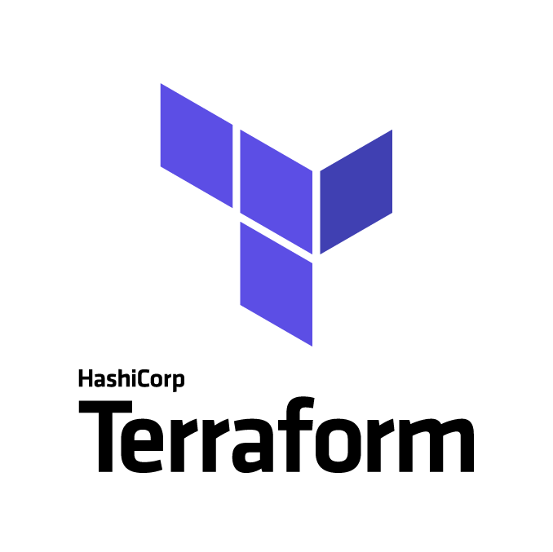

Infrastructure-as-Code (IaC)
An Introduction to Terraform
OWASP South Florida Chapter Meeting
27th, January 2021

Slide 2
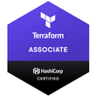



Today’s Presenter
Pradip Gupta
Leader, Attain LLC.
Pradip.gupta@gmail.com
https://www.linkedin.com/in/pradipgupta/
Rose Gupta
SRE Tools Engineer, Malwarebytes Inc
rosegupta98@gmail.com
https://www.linkedin.com/in/rose-gupta/
The Data Scientist's Toolbox – Coursera Verified Certificates
DevOps Practitioner Training – Simplilearn Certificate
R Programming – Coursera Verified Certificates
Oracle Certified Expert (OCE) – Oracle SOA Foundation Practitioner
Sun Certified Java Developer (Java 1.4)
Oracle Certified Professional (OCP) – Database Administration
Oracle Cloud Infrastructure Foundations 2019 Associate
Oracle Cloud Infrastructure 2019 Architect Professional
HashiCorp Certified: Terraform Associate
Ever since I was a kid, my goal in life has been to make in impact in whatever I do. My love for math since childhood has translated into developing new systems, helping technology, helping security. From writing my first “Hello World” program in Java, to learning about software development life cycles and advanced mathematics.
Bachelor in Computer Science – University of Miami
Doing Master Computer Engineering: Network Security – FIU
Oracle Cloud Infrastructure Foundations 2019 Associate

Slide 3
Agenda
Infrastructure as Code – Why?
Terraform How it works
Terraform Basics
Provider
Resource
Terraform Commands
Init
Plan
Apply
Destroy
Terraform Advance
Variable
Count Parameters
Function
Data sources
Demo
Knowledge Check
Q & A

Slide 4
Terraform Basics

Slide 5
Why Infrastructure As Code?
Infrastructure as Code can help avoid cloud deployment inconsistencies, increase developer productivity, and lower costs.
Speed and simplicity
IaC allows you to spin up an entire infrastructure architecture by running a script.
Configuration consistency
IaC completely standardizes the setup of infrastructure so there is reduced possibility of any errors or deviations.
Minimization of risk
Because code can be version-controlled, IaC allows every change to your server configuration to be documented, logged, and tracked.
Increased efficiency in software development
Cloud architectures can be easily deployed in multiple stages to make the software development life cycle much more efficient.
Cost savings
As mentioned earlier, your IaC script can automatically spin down environments when they’re not in use, which will further save on cloud computing costs.
If you can’t audit and repeat the actions that built your infrastructure, you can’t depend on it
Dependable
It’s difficult to audit physical infrastructure
Auditable
Repeatable
Going through hundreds of different human interfaces with clicks and screens on cloud provider's web UI isn't the kind of thing that's easy to replicate 100% accurately

Slide 6
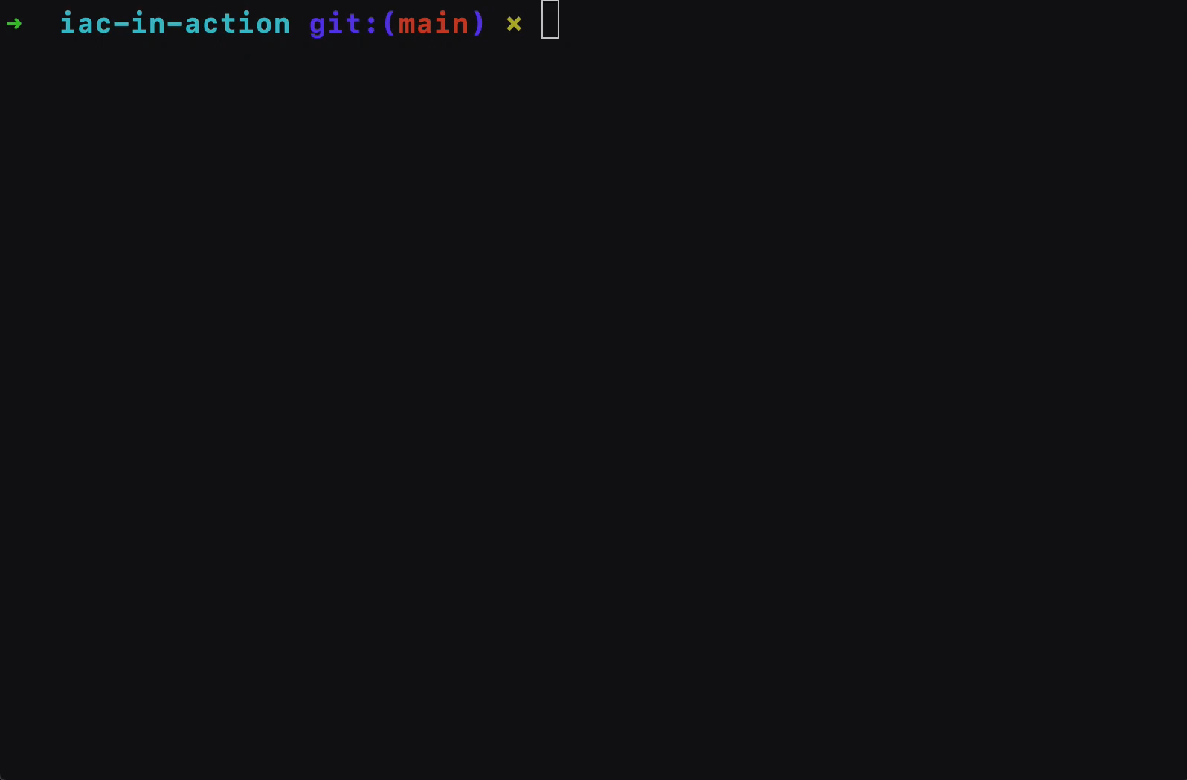
Terraform - how does it work
Terraform is an open-source infrastructure as code(IaC) software tool that provides a consistent CLI workflow to manage hundreds of cloud services. Terraform codifies cloud APIs into declarative configuration files.
Building Infrastructure
Multi cloud infrastructure providers
Ensure Creation and consistency
Incremental changes
Destroy
Easy scale
Advantage
Create resources in the right order without regard to the order in the terraform plan file
Automatically re-provision the resources that are tainted or whose configuration has changed
Automatically destroy all the resources that are in tenancy.

Slide 7
Terraform Basics
Commands/Workflows
Init
Plan
Apply
Destroy
Resource Creation
Resources Types
Configurations
File Structure
Backends
Providers
Variables
Outputs
Init
Plan
Apply
Destroy

Slide 8
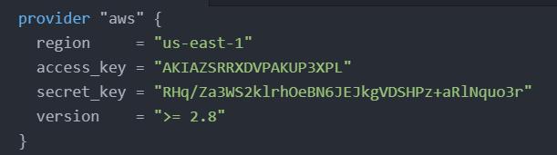
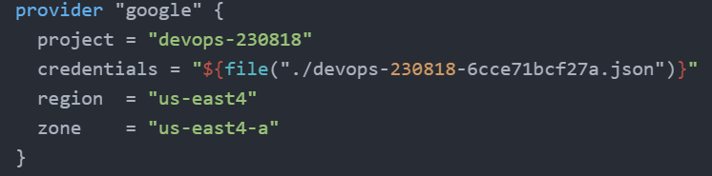
Terraform Basics
Provider
Terraform supports multiple providers.
We have to specify the provider details for which we want to launch the infrastructure for.
With the provider, we also have to add the tokens which will be used for authentication.
On adding a provider, terraform init will download plugins associated with the provider.
Example:
AWS Access & Secret Keys.
Google JSON Credentials.

Slide 9
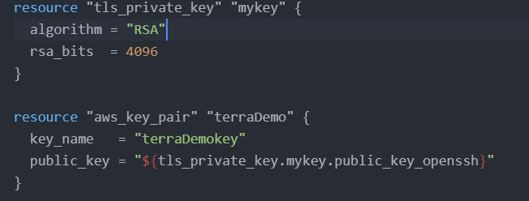
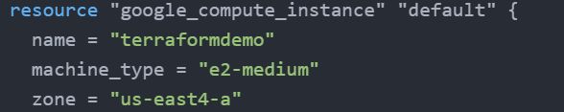
Terraform Basic
Resource
Resources are the reference to the individual services which the provider has to offer
Example:
resource aws_instance
resource aws_alb
resource iam_user
resource google_compute_instance

Slide 10
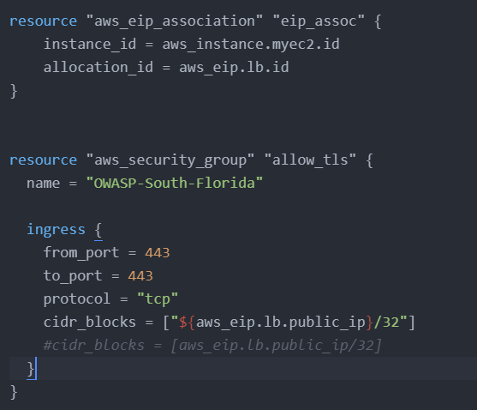
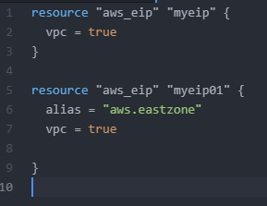
Terraform Basics
Resource Block
Each resource block describes one or more infrastructure objects, such as virtual networks, compute instances or higher-level components such as DNS records

Slide 11
Terraform commands

Slide 12
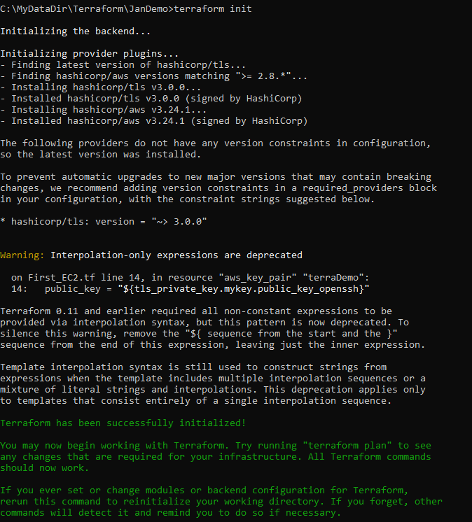
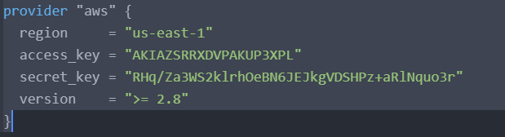
Terraform Commands
Terraform Init
Each resource block describe one or more infrastructure objects, such as virtual networks, compute instances or higher-level components such as DNS records

Slide 13
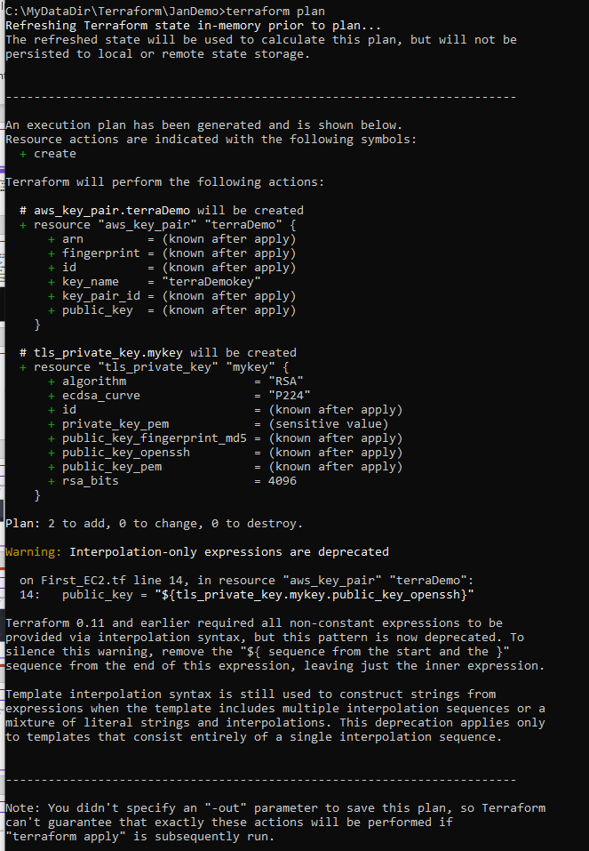
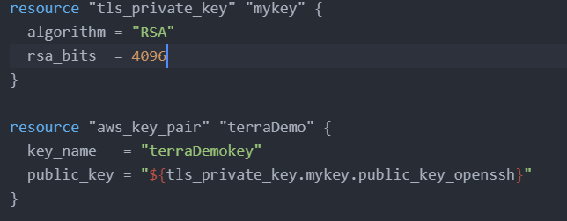
Terraform Command
Terraform “Plan”
Each resource block describe one or more infrastructure objects, such as virtual networks, compute instances or higher-level components such as DNS records

Slide 14
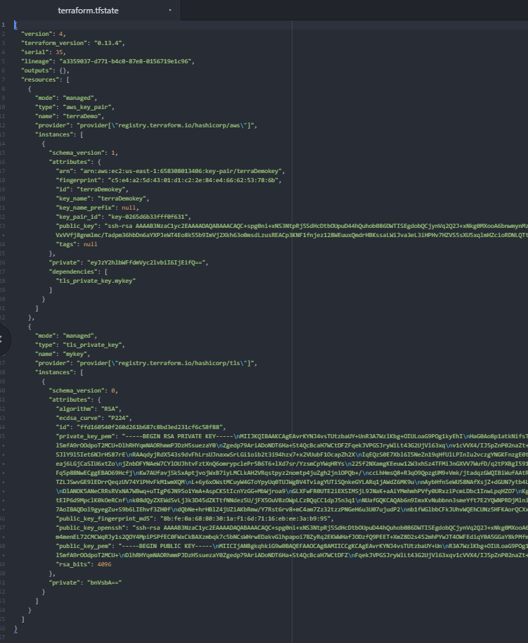
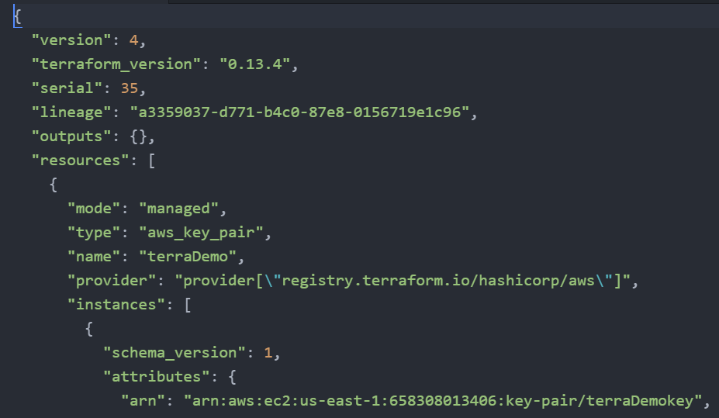
Terraform Command
Terraform State File
Terraform stores the state of the infrastructure that is being created from the TF files.
This state allows terraform to map real-world resource to your existing configuration.

Slide 15
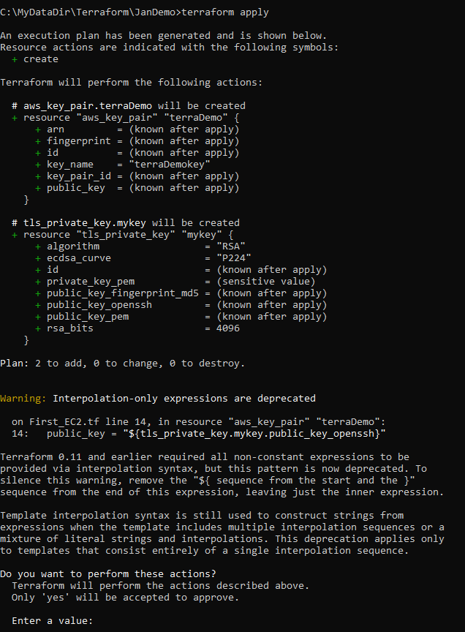
Terraform Commands
Terraform “apply”
Each resource block describe one or more infrastructure objects, such as virtual networks, compute instances or higher-level components such as DNS records

Slide 16
Terraform Commands
Terraform “destroy”
Each resource block describe one or more infrastructure objects, such as virtual networks, compute instances or higher-level components such as DNS records

Slide 17
Terraform advance

Slide 18
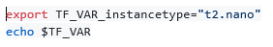
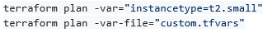
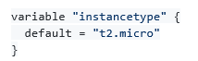
Terraform Variables
Repeated static values can create more work in the future
Terraform Variables allows us to centrally define the values that can be used in multiple terraform configuration blocks
Variables in Terraform can be assigned values in multiple ways.
Environment variables
Command Line Flags
From a File
Variable Defaults
Environment Variables:
Command Line Flags:
From a File (terraform.tfvars):
Variable Defaults:

Slide 19
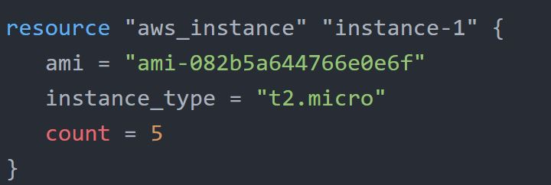
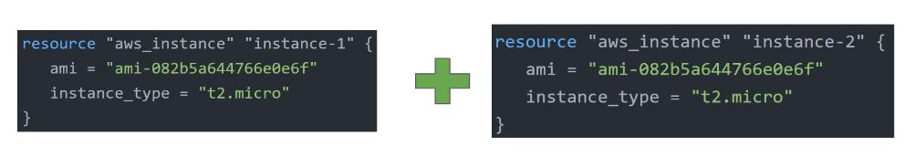
Terraform Count Parameters
The count parameter on resources can simplify configurations and let you scale resources by simply incrementing a number.
Let’s assume, you need to create two EC2 instances. One of the common approaches is to define two separate resource blocks for aws_instance.

Slide 20
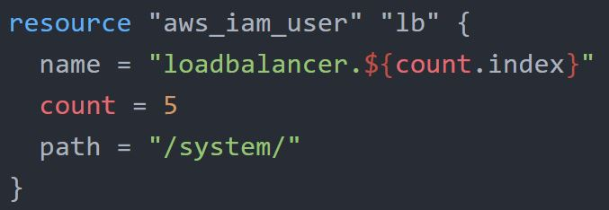
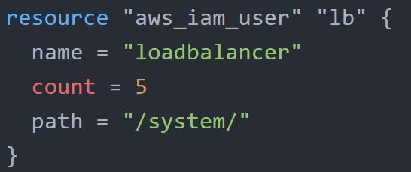
Terraform Count Parameters
Count Parameter [Challenges]
With the below code, terraform will create 5 IAM users. But the problem is that all will have the same name.
count.index allows us to fetch the index of each iteration in the loop.

Slide 21
Terraform Function
The Terraform language includes a number of built-in functions that you can use to transform and combine values.
The general syntax for function calls is a function name followed by comma-separated arguments in parentheses:
function (argument1, argument2) i.e : > max(5, 12, 9)
The Terraform language does not support user-defined functions, and so only the functions built into the language are available for use
Numeric
String
Collection
Encoding
Filesystem
Date and Time
Hash and Crypto
IP Network
Type Conversion

Slide 22
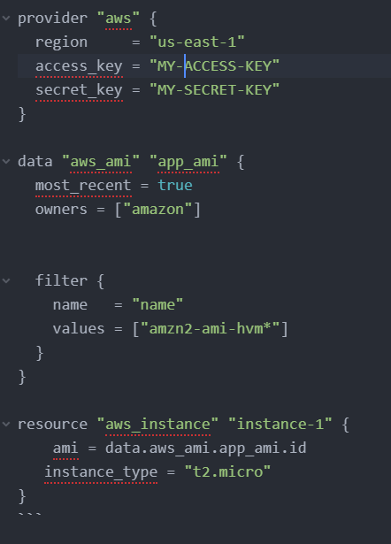
Terraform Data Source
Data Source
Data Source allow data to be fetched or computed for use elsewhere in Terraform configuration
A data source is defined under the data block.
It reads from a specific data source (aws_ami) and exports results under “app_ami”
EC2 Instance
Asia
Ami-1234
East
Ami-5678
West
Ami-XXXX
Central
Ami-000

Slide 23
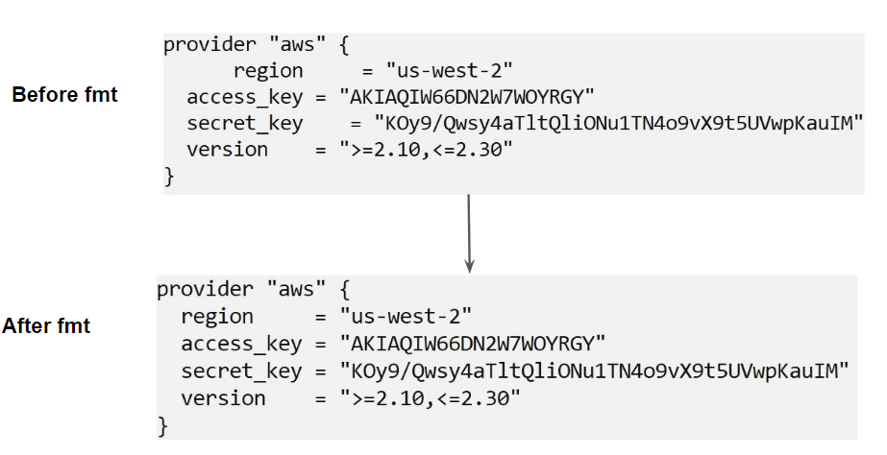
Terraform Basics
Terraform Format
Anyone who is into programming knows the importance of formatting the code for readability.
The terraform fmt command is used to rewrite Terraform configuration files to take care of the overall formatting

Slide 24

Terraform Basics

Slide 25
Demo

Slide 26
Prerequisites
Install Terraform
https://www.terraform.io/downloads.html
AWS account
https://aws.amazon.com/
ATOM Editor [A hackable text editor for the 21st Century]
https://atom.io/

Slide 27
Knowledge check

Slide 28

Check - I
You have recently joined a company who are too new to terraform and you have been instructed to teach develops on basics on terraform what is the workflow you will suggest then?
A. Learn terraform write code and push to git and start deploying the infrastructure
Create a terraform state with all the requirements and do terraform apply every time you deploy
Write a code, do terraform plan and then terraform apply to properly deploy the infrastructure
Learn as you go, deploy get your hands on terraform

Slide 29
Check - II
Which of the following is not a native Infrastructure as tool (IaC)?
A. Cloudformation
B. Azure Resource Manager
C. Terraform
D. Puppet

Slide 30
check - III
What are the benefits of using Terraform compared to other infrastructure management tools with resect to multi-cloud scenario
Terraform is cloud agnostic
We can define all cloud providers in a single provider block
Terraform can handle cross-cloud dependencies
Terraform cannot handle cross-cloud dependencies and should be handled manually

Slide 31
check - IV
Which among the below cloud service provider do not officially have a provider maintained by HashiCorp?
AWS
Digital Ocean
Azur
IBM
Oracle
Openstack

Slide 32
check - V
What does Terraform use to create, manage, and manipulate infrastructure resources?
Resources
Provisioner
Instances
Provider

Slide 33

Certification Resources
Study Guide - Terraform Associate Certification
Exam Review - Terraform Associate Certification
Sample Questions - Terraform Associate Certification

Slide 34

Q & A

